Slide 1
Applied Math 3 Week 4 Rotation “Fun”-Damentals I*
* Not guaranteed to be fun

Slide 2
Add a couple more examples here.
Dealing with rotations in Unreal can be tricky.
You will encounter rotation problems constantly however so it is important to understand the tools you have to work with them.
Just like vector math is critical to moving objects, understanding trigonometry is important for rotation of objects.

Slide 3
Unreal Rotators Definition
The Rotator object defines a single rotation in 3D space.
The rotation data in a Transform is a Rotator for example.
You can also create Rotator objects by defining their 3 axes of rotation individually.

Slide 4
Unreal Rotators Definition
Dealing with rotations in Unreal can be tricky, particularly because the documentation is terrible.
There is an extensive description of a Rotator in the Unreal documentation. It reads:
“Rotator”
Yes, that’s it. Document your code kids. (Does include methods though)
https://docs.unrealengine.com/4.27/en-US/BlueprintAPI/Math/Rotator/
Some actual docs here:
https://docs.unrealengine.com/4.26/en-US/BuildingWorlds/LevelEditor/Details/Properties/VectorAndRotator/

Slide 5
Rotation Notation: Euler Angles
A Rotation object in Unreal is a struct (data structure) that stores rotation data.
On the surface (ie in blueprint, in transforms) a Rotation is stored using a 3D Vector of Eular angles. These are the typical angle measurements you have seen in trigonometry problems before.
Eulers are the familiar X, Y, Z angles stored in degrees and have a range from (0*, 360*). If you enter an angle greater or less then this range, it will get mapped to the angle within the range (it wraps around basically).
For example 720* is the same value as 360*, or 540* is the same as 180*.
*This can cause issues when you are rotating from a Rotation to another, as it may “wrap” the wrong way.

Slide 6
Rotation Notation: Euler
Euler Rotation Format stores the rotation as 3 Euler angles.
Stored as three separate rotation values, one for each axis (X, Y, Z).
Recall: When moving (in Unreal, in 3D):
X Axis represents Forward
Y Axis represents Right
Z Axis represents Up
The rotation axes rotate around the same axis the movement occurs in.
X Axis Rotation represents Roll (Tilt your head from side to side)
Y Axis rotation represents Pitch (Nod your head)
Z Axis rotation represents Yaw (Turn your head to look left and right)

Slide 7
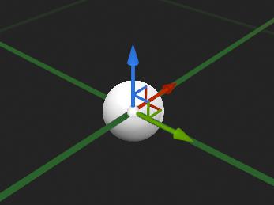
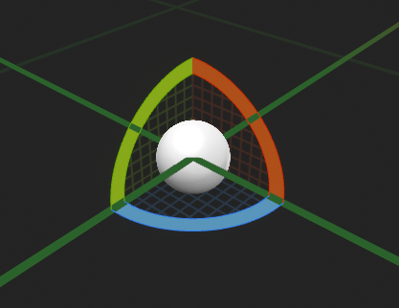
Rotation Notation

Slide 8
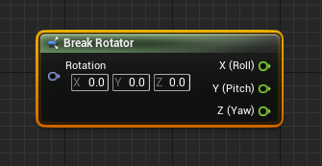
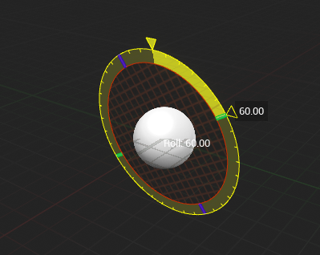
Rotation Notation
If you imagine facing in the direction of a given movement axis, a positive rotation in that axis will rotate it clockwise by degrees. A negative rotation in that axis will rotate counter-clockwise.

Slide 9
Rotation Notation: Vector Axis of Rotation
We can also convert the Rotation object to a series of Vectors that represent the amount of each direction that is used.

Slide 10
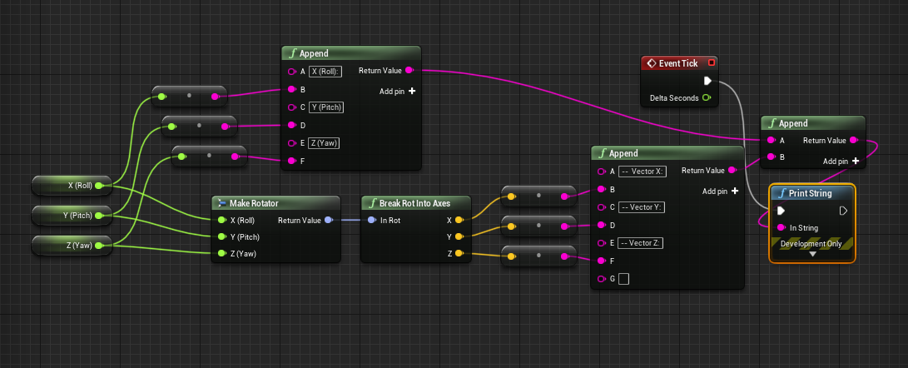
Rotation Notation: Vector Axis of Rotation

Slide 11
Rotation Notation: Vector Axis of Rotation
The output we get from the previous slide is interesting. Here are some examples of different input values.
The X,Y,Z input is expressed in Degrees, as an angle.
In this first example, the Vectors produced are unit vectors that point in the X, Y and Z direction.

Slide 12
Rotation Notation: Vector Axis of Rotation
The second example is similar, except the Y vector now points in the –Z direction, and the Z points in the Y direction. This is due to it being rotated by 90*. The X Vector is unchanged because we are rotating our rotator AROUND the X axis.

Slide 13
Rotation Notation: Vector Axis of Rotation
The third example is the most interesting. Where have you seen the number 0.707 expressed before?

Slide 14
Rotation Notation: Vector Axis of Rotation
The third example is the most interesting. Where have you seen the number 0.707 expressed before?
(Hint: In Trigonometry)

Slide 15
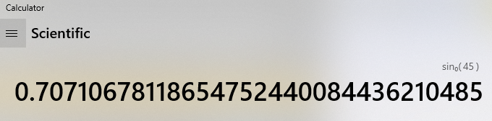
Rotation Notation: Vector Axis of Rotation
The third example is the most interesting. Where have you seen the number 0.707 expressed before?

Slide 16
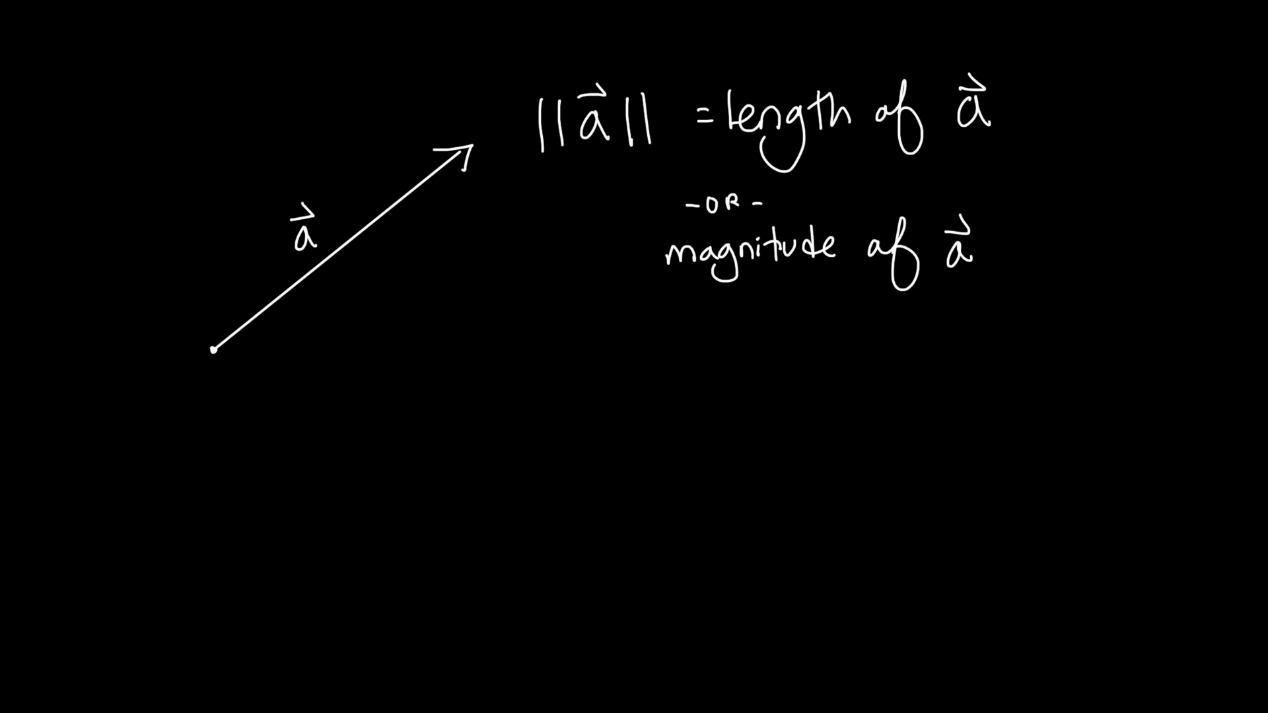
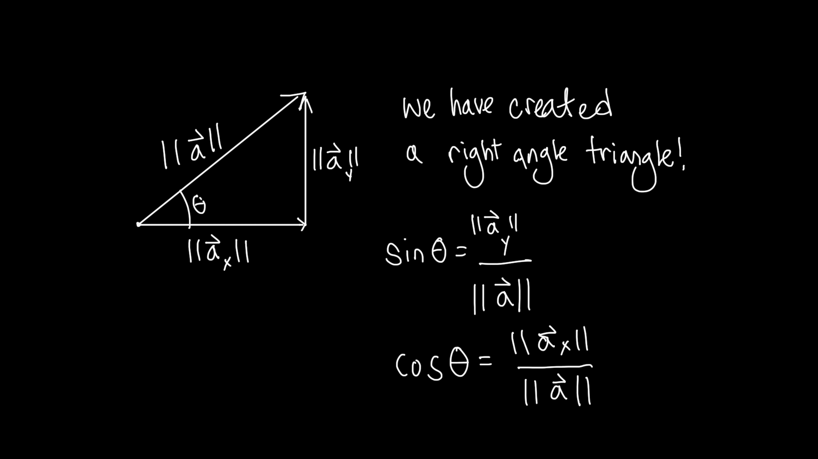
Vectors and Trig: Who cares anyway?

Slide 17
Vectors and Trig: They are the same!

Slide 18
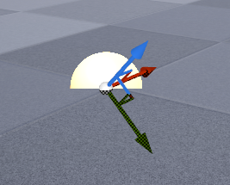
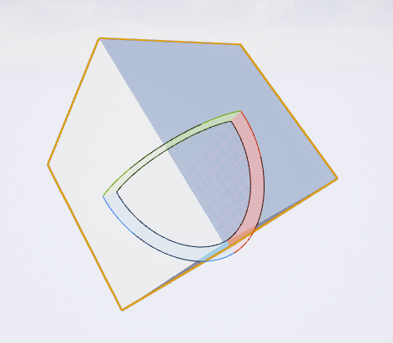
2D to 3D Trig: Rotated 45* on X aXis
As you can see in the diagram, we are seeing 0.707 as the Y and Z axis are basically at a 45* angle to the world axis.
This is to say, everything we learned about Sine and Cosine holds up in 3 dimensions!
We just have to be careful about which axis we are referencing as the base.

Slide 19
Rotation Notation: Vector Axis of Rotation
Look at our data again for our object rotated 45* on X.
The X Vector red (X = 1.0, y = 0, z = 0)
The Y Vector is green (X = 0, Y = 0.707, Z = -0.707)
The Z Vector is blue (X = 0, Y = 0.707, Z = 0.707)
So what we have done is convert our Rotation orientation into its three component unit vectors.

Slide 20
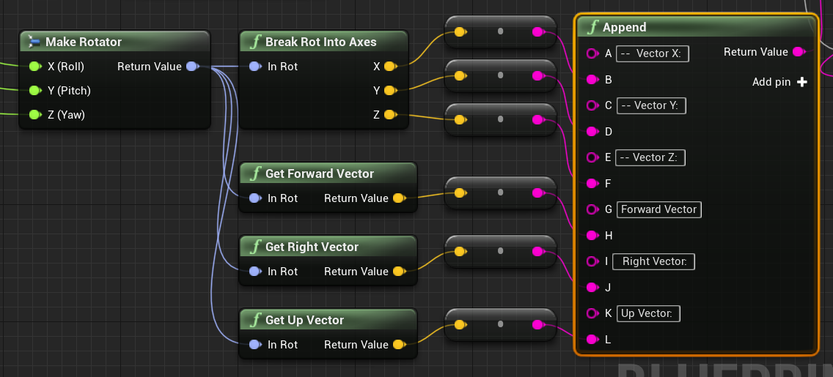
Note: These do exactly the same thing!

Slide 21
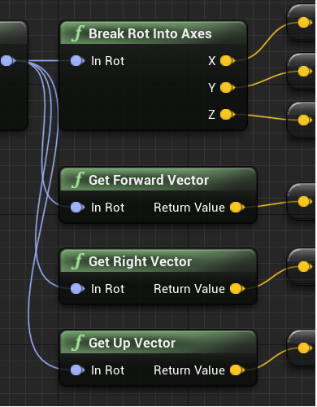
Rotation Notation: Vector Axis of Rotation
The X Axis from the Break is the same as the Forward Vector
The Y is the same as the Right Vector
The Z Axis is the same as the Up Vector

Slide 22
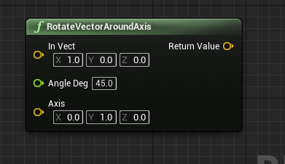
Rotation Notation: Vector Axis of Rotation
It is important to understand the different ways a rotation can be stored as you will sometimes need to use each.
For example, when you want to rotate a Vector around a specified axis, you can use the RotateVectorAroundAxis node, which specifies both the vector to rotate, as well as the axis to rotate it around.
HOWEVER, it requires the axis in the form of a vector, so you will need to be able to understand what Unreal is asking for to be able to use this node.

Slide 23
Rotation Notation: Quaternions
While we have talked a lot about the Rotation object type, you should be aware that internally the data is stored as a Quaternion.
Quaternions are 4 dimensional data types that you don’t normally work with directly or worry about. They are used because they avoid several problems that occur when trying to rotate 3 dimensional Euler angles.
For now, I am just going to hand wave it away, but we may touch on it later. (If you are interested in researching it yourself, we are trying to avoid “Gimbal Lock”)

Slide 24
TODO:
In-Class challenges:
Rotate your Pawn around a given axis (such as the Z axis) when input is applied.
Rotate your pawn art component to face a given target (will require the vector math from last week as well).
Hint: if you don’t want to spin wildly you will have to control the axis.
Rotate your pawn in 45* increments when you add input.
Hard Mode: Rotate towards a target at a fixed speed.
Hard Mode 2: Rotate towards a target, easing in and out of the movement.

